Slide 1
Product Vision & Project Scope
By: Bryan Peterson

Slide 2
Summary of Topics
Vision and Scope Document
  What is it?
  Why do you need it?
  What does it contain?

Slide 3
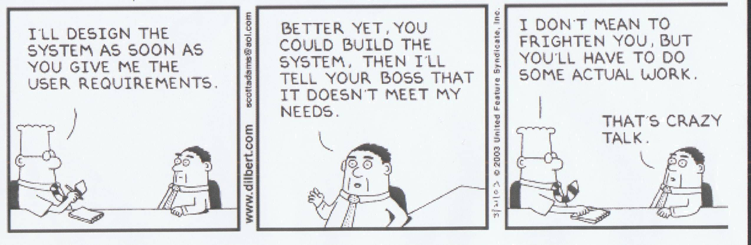
Humor

Slide 4
Intro
The vision and scope document collects the business requirements into a single document that sets the stage for the subsequent development work.
Notes:
-Some organizations create a project charter or a business case document that serves a similar purpose.
-This can help to control scope creep in which stakeholders overstuff the new system in an attempt to satisfy every conceivable interest and make the project topple under its own weight, never delivering anything of value.

Slide 5
Need for vision and scope doc
The user requirements and software functional requirements must align with the context and objectives that the business requirements establish.
A project that lacks clearly defined and well-communicated direction invites disaster.
A clear vision and scope is especially critical for multi-site development projects, where geographical separation inhibits the day-to-day interactions that facilitate teamwork.
Notes:
-The business requirements represent the top level of abstraction in the requirements chain: they define the vision and scope for the software system.
-The stakeholders will never agree on the requirements if they lack a common understanding of the business objectives for the product.
-One sign that the business requirements are insufficiently defined is that certain features are initially included, then deleted, and then added back in later. Vision and scope issues must be resolved before the detailed functional requirements can be fully specified.

Slide 6
Defining Terms
Product vision: aligns all stakeholders in a common direction
Project scope: identifies what portion of the ultimate long-term product vision the current project will address.
The vision applies to the product as a whole and will change relatively slowly.
Scope is more dynamic than vision.
Notes:
-The vision describes what the product is about and what it eventually could become.
-The statement of scope draws the boundary between what’s in and what’s out.
-That is, the scope also define the project’s limitations.
-The details of a project’s scope are represented by the requirements baseline that the team defines for that project.

Slide 7
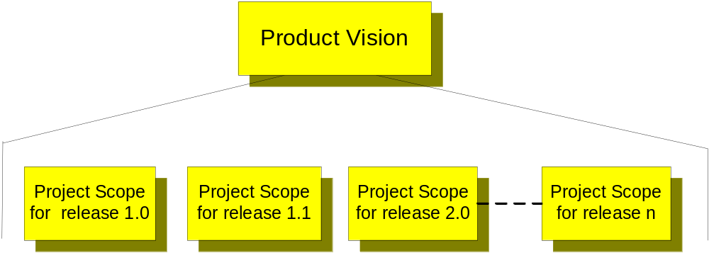
Project Vision Diagram

Slide 8
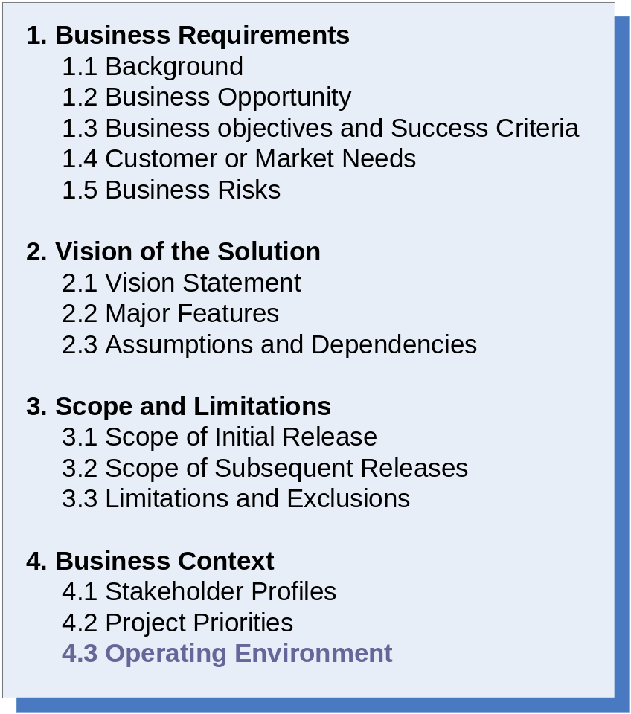
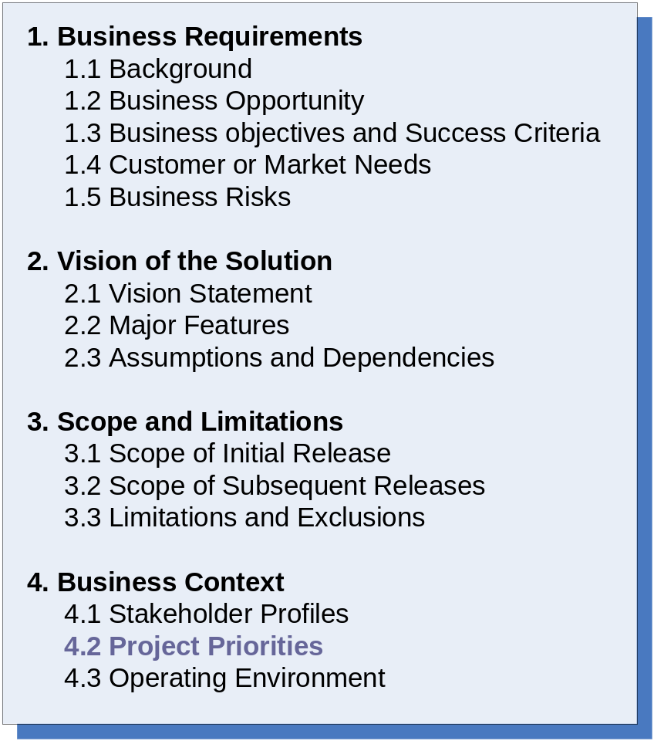
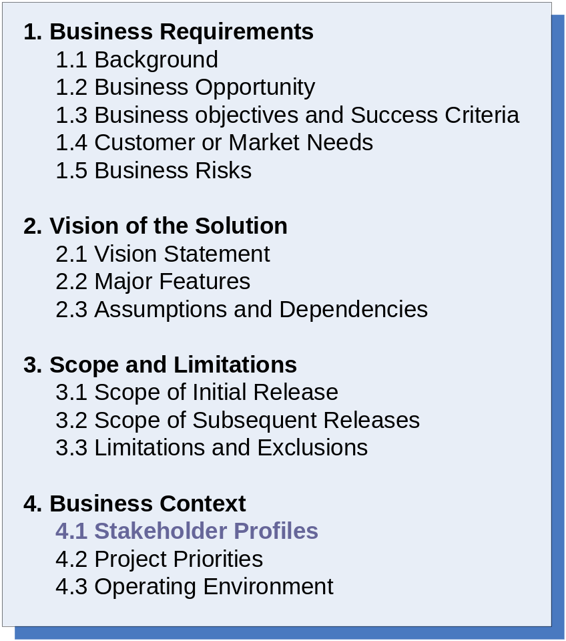
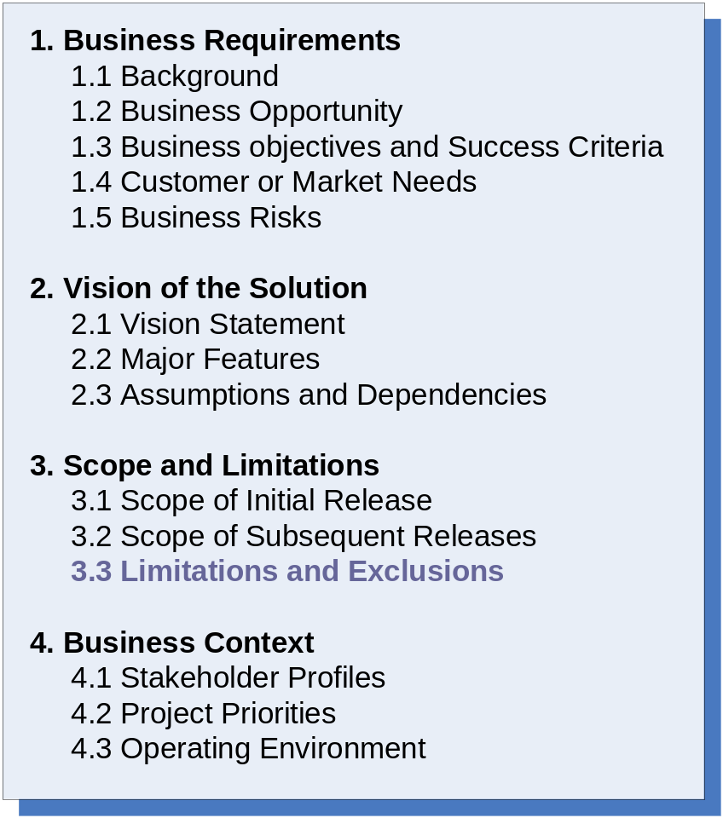
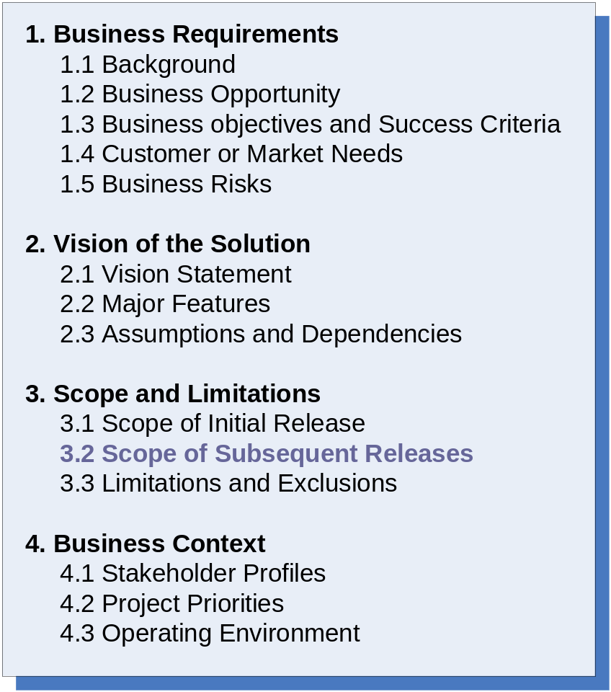
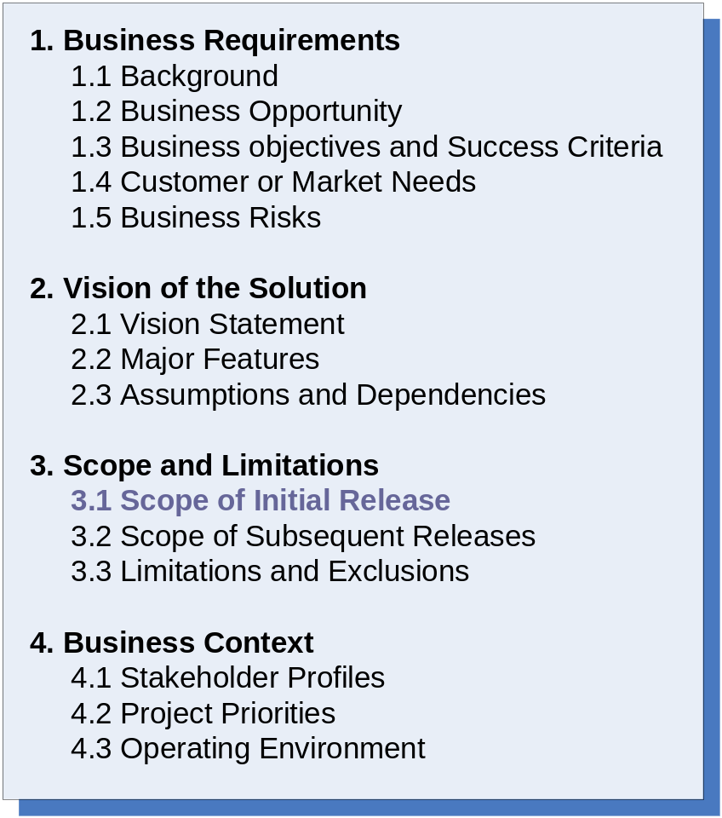
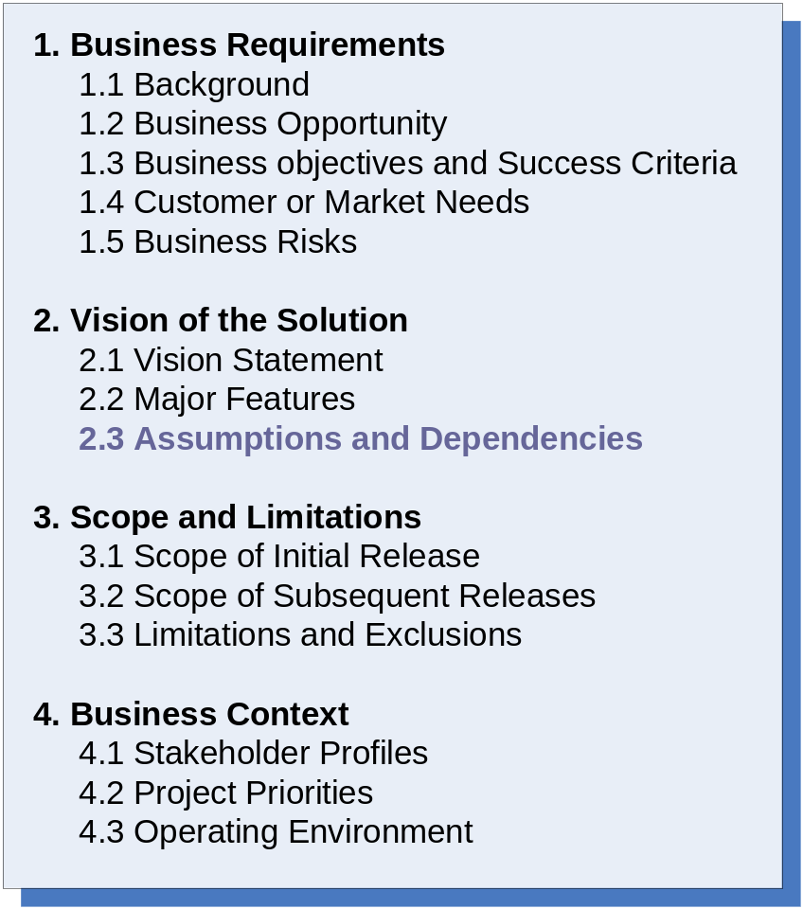
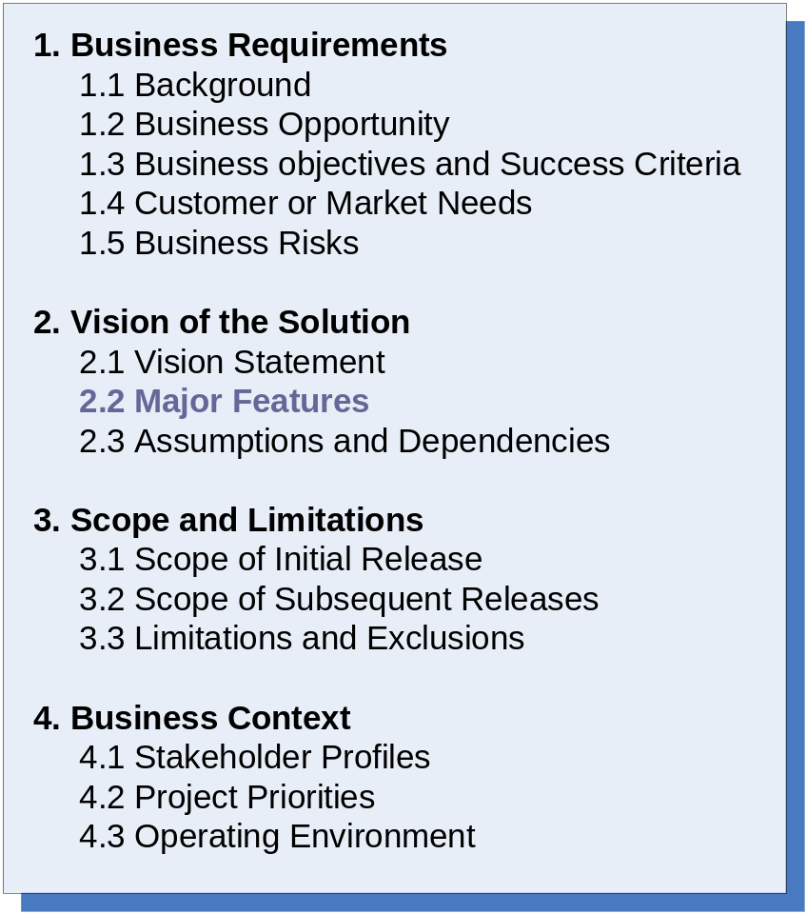
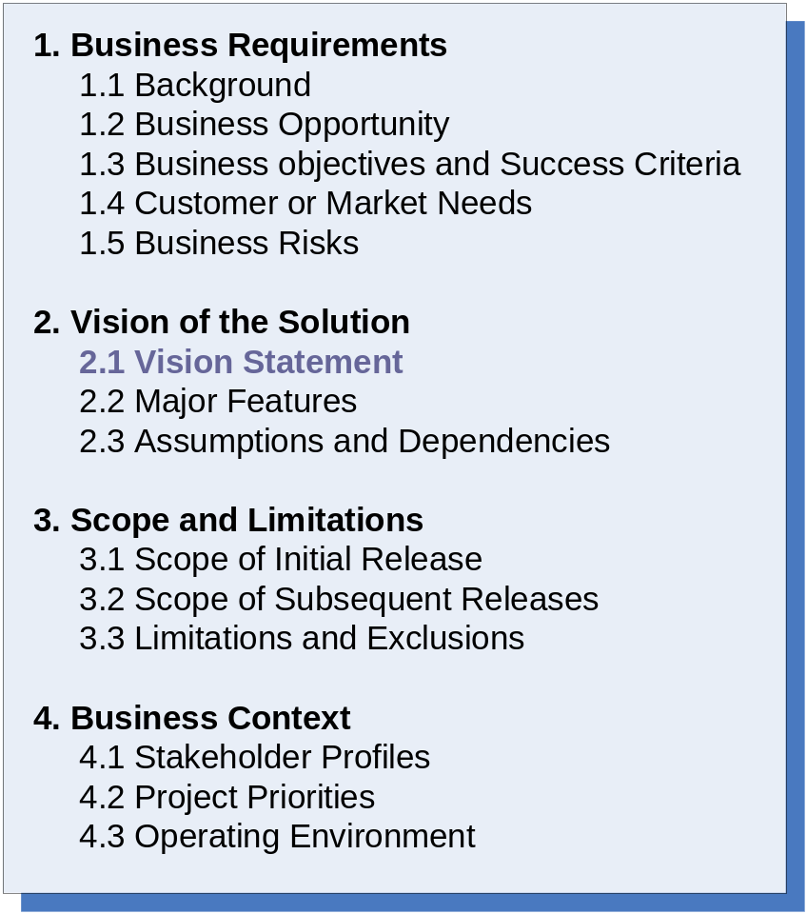
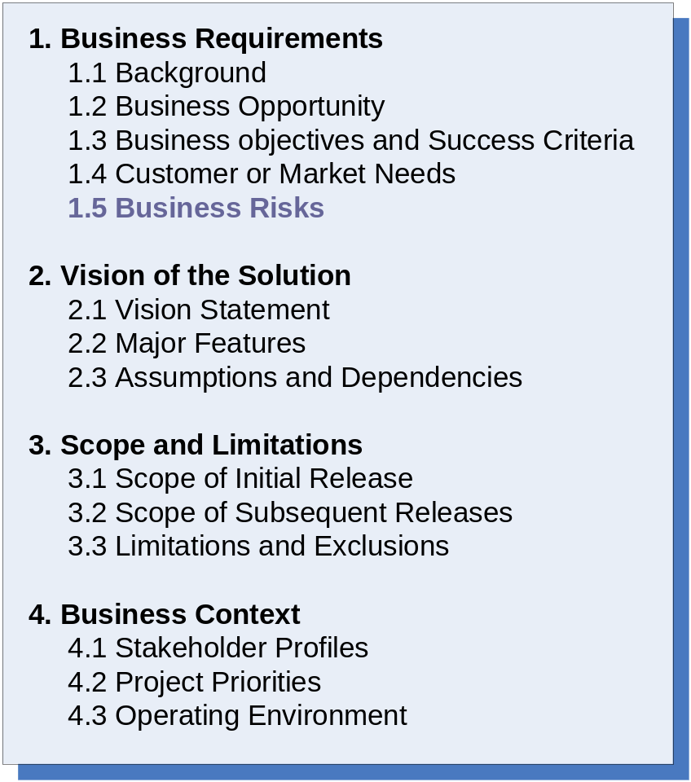
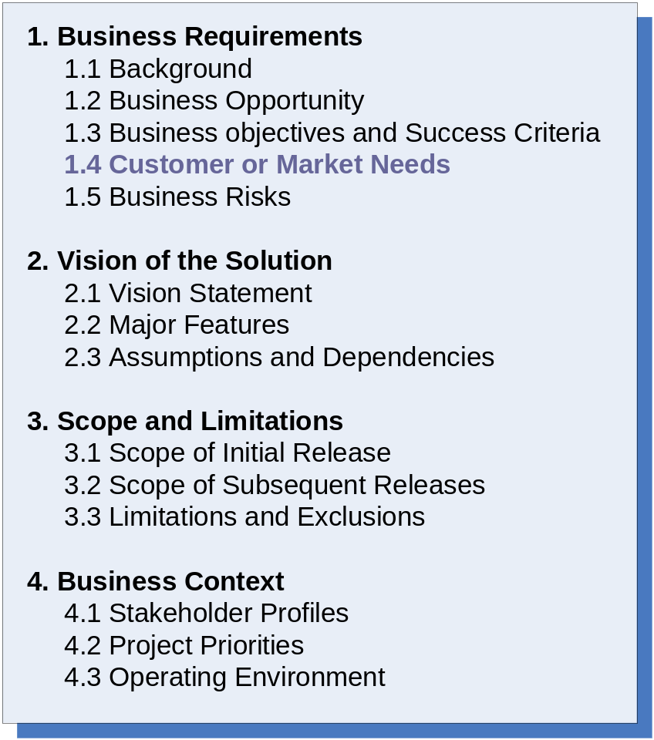
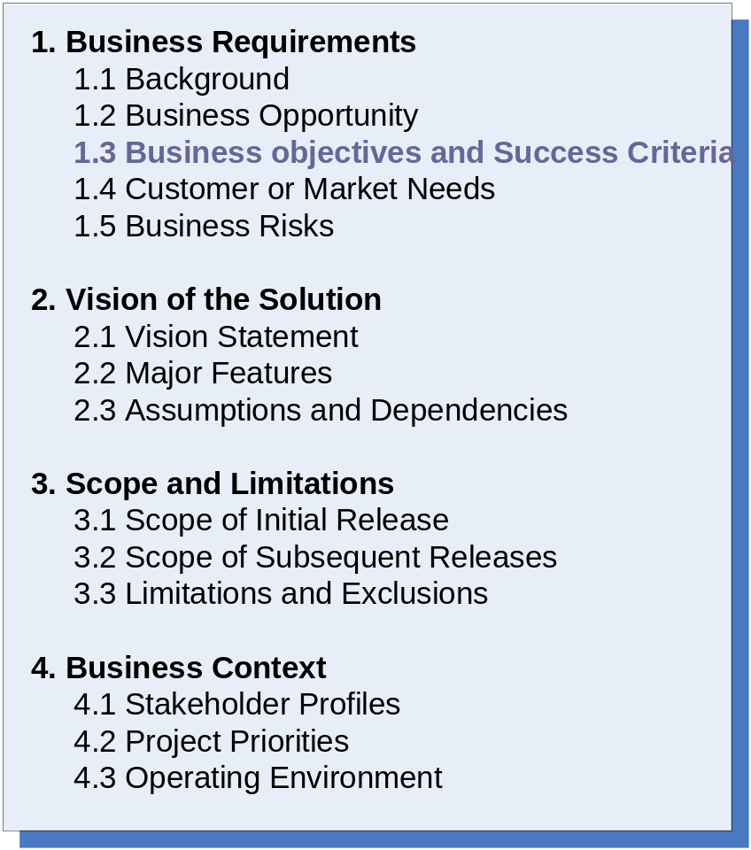
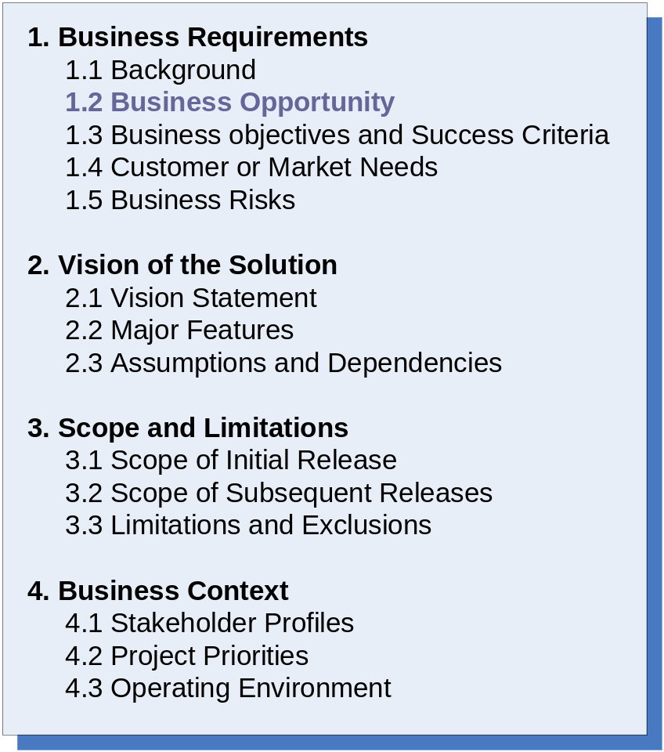
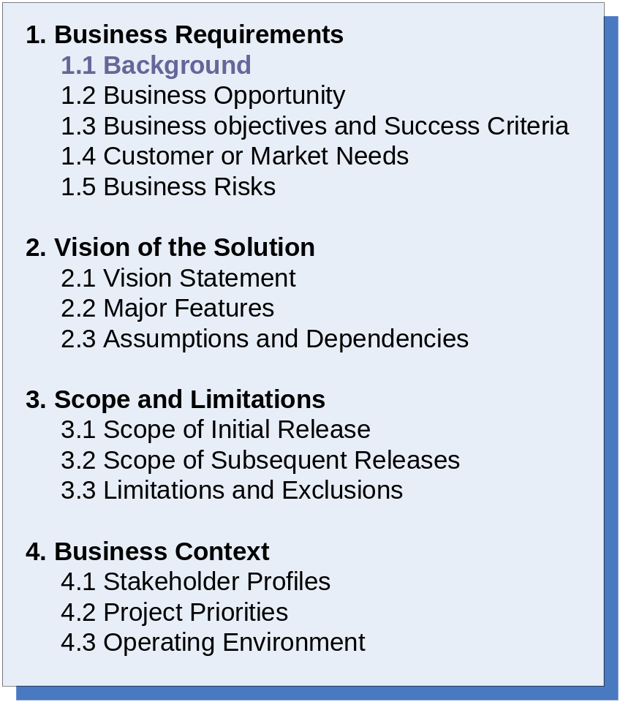
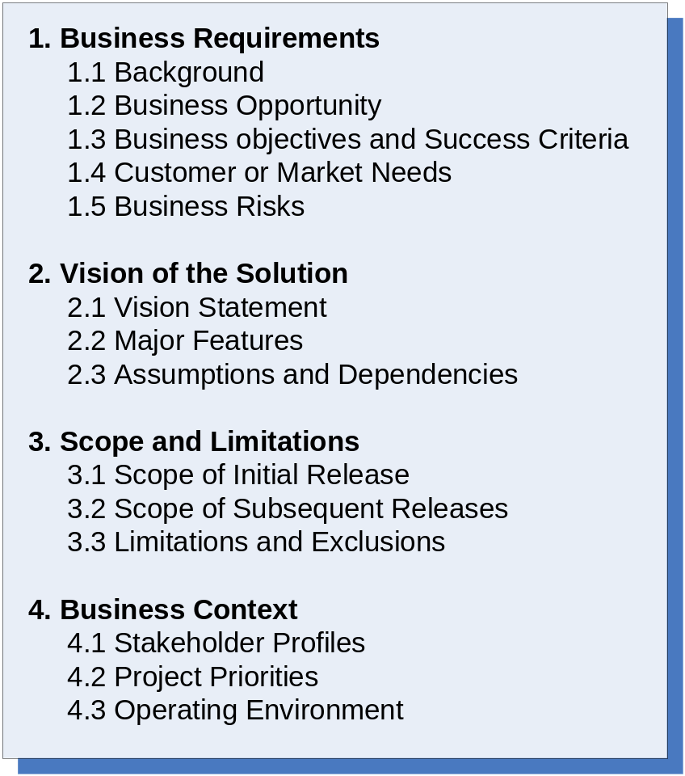
Vision and Scope Document
Notes:
-Some of the parts may seem repetitive, but they should interlock in a sensible way.
-background: Tells us why we are undertaking this new project. It provides a description of the history or situation that led to the decision to build this product.
-business opportunity:
Business Objects and Success Criteria: Shows how the product will benefit the business. It also determines how the stakeholders will define and measure success on this project.
Customer or Market Needs: Describes the needs of typical customers or of the target market segment.
Business Risks- Summarize major business risk associated with developing or not developing this product.
Vision statement- Summarizes the long-term purpose and intent of the new product.
Limitations and Exclusions- Defines what’s in and what’s out and helps manages scope creep.
Operating Environment- Describes the environment in which the system will be used and defines availability, reliability, and performance requirements.

Slide 9
Conclusion
The product vision and project scope is important in giving a project direction.
It manages scope creep and “gold-plating”
Having a clearly defined product vision and project scope can save you time as a requirements analyst in defining use cases and their implementation priorities.

Slide 10
References
Wiegers, Karl E. Software Requirements. 2nd edition. Microsoft Press, 2003.

